Slide 1
Obstacle Avoiding Car
CSE323.3
Operating Systems Design

Slide 2

Group - 7
NAME | ID
Tahsinul Refat | 2122194642
Maisha Hasan | 2011208042
Anika Hossain | 2111687642
Arifa Akbir Srity | 2021149642

Slide 3
Component List
Name | Quantity | Component
A1 | 1 | Arduino Uno R3
M1, M2, M3, M4 | 4 | DC Motor
U2 | 1 | H-bridge Motor Driver
SW1 | 1 | Slideswitch
BT2 | 1 | 4 batteries, AA, no 1.5V Battery
U1 | 1 | Ultrasonic Distance Sensor
M5 Motor Servo | 1 | Positional Micro Servo

Slide 4

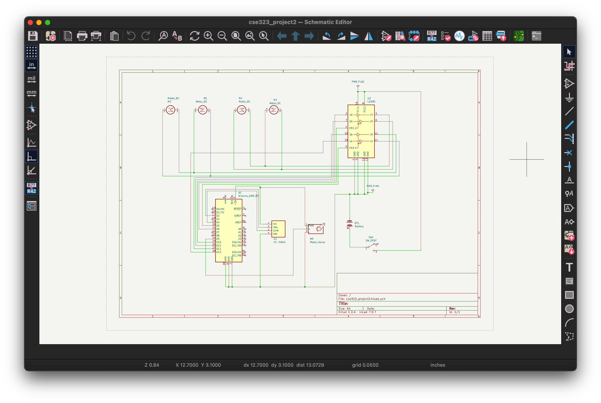
KiCad Screenshot

Slide 5

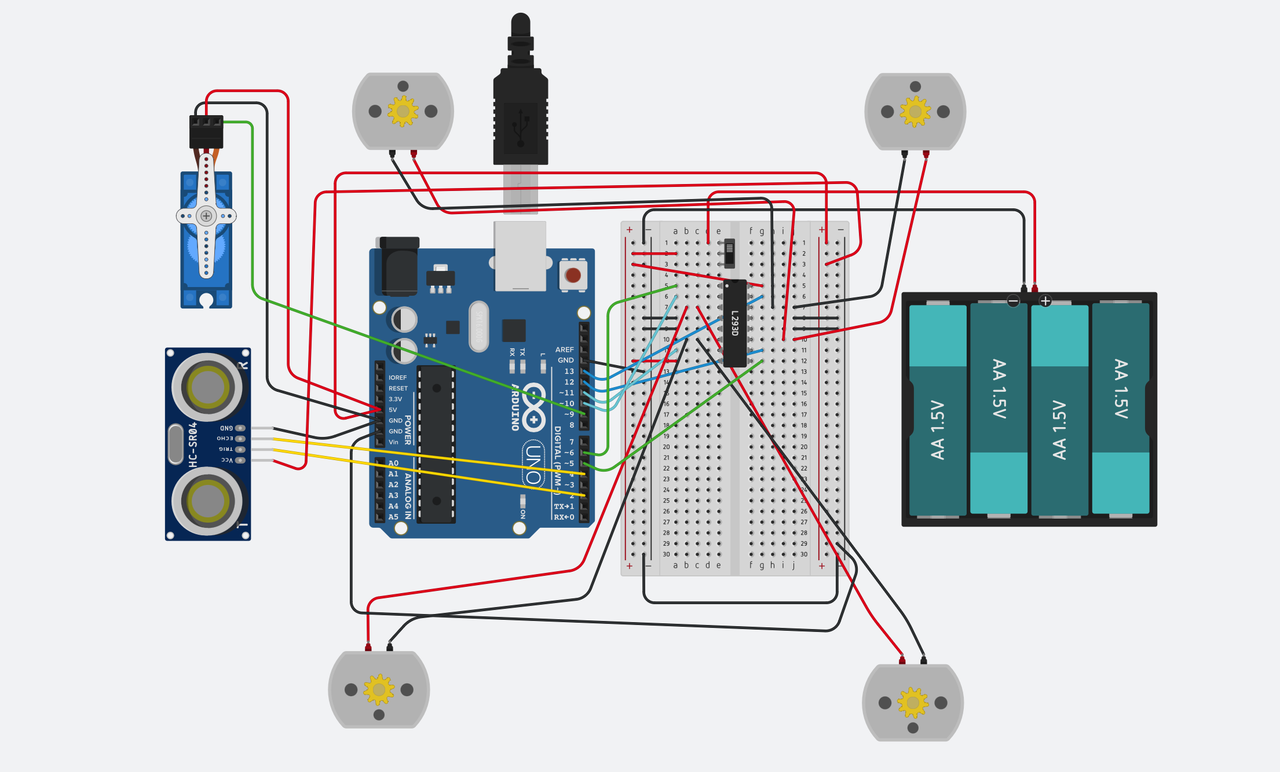
TinkerCad Screenshot

Slide 6

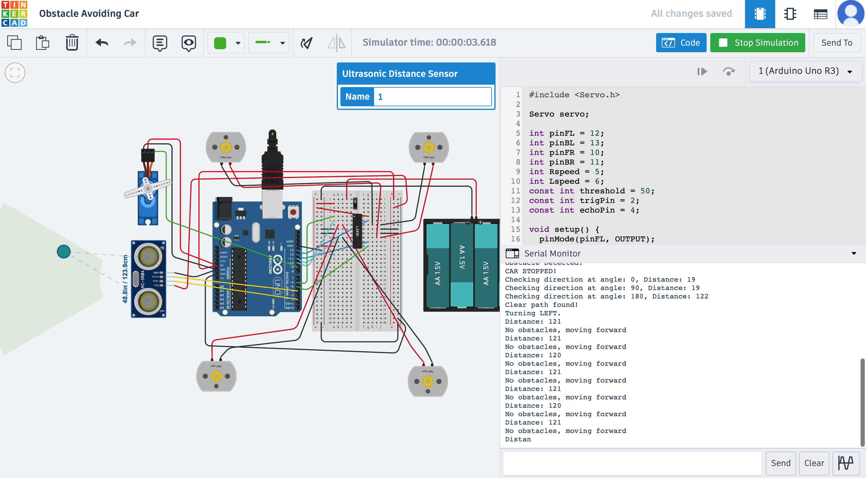
TinkerCad Simulation

